Slide 1
Uosm Robotics Club 2018-2019 part 1
2nd class of Arduino Module

Slide 2
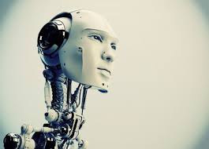
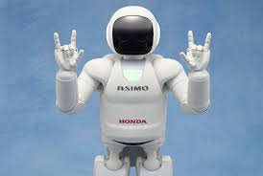
What defines a robot?
Despite to common believe, robots do not necessary look like what we see in movies.
In definition, robots are machines are able to act accordingly to changes in the environment and make decisions, that includes cars, air-conditioners and even your rice-cooker!!

Slide 3
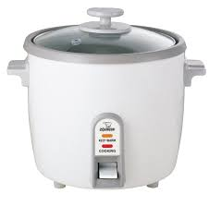
My rice cooker is a robot??
Technically yes, that is because your rice cooker has buttons and specific sensors to make decisions on what type of rice it should cook, how long it should cook them etc.
How Skynet’s Grandpa looks like:

Slide 4
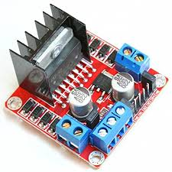
ln298n Motor Driver
In this course, we will be learning how to use a motor-driver to control DC motors to built a simple moving robot.
We will start programming after the presentation since the robot chassis is already built for you.

Slide 5
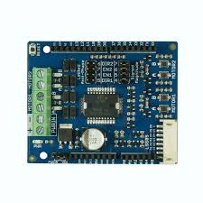
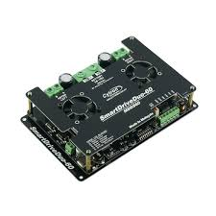
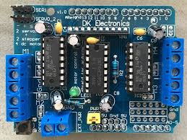
What are motor-drivers?
They are considered as your microcontroller’s workmen, same to workers in a factory, a boss cant run a factory on its on!
A motor-driver protects the microcontrollers from burning since dc motors drive strong currents(some can reach to 60A!) from battery and microcontrollers are built to handle small currents (a few mA).

Slide 6
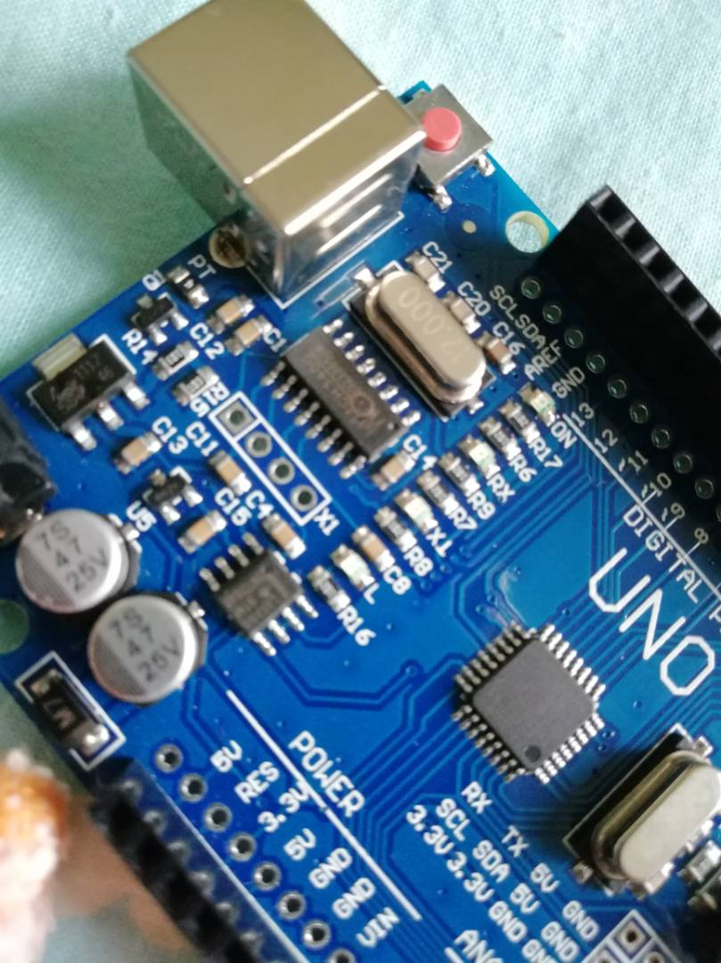
A perfect Example of a burnt Arduino uno:
Can you spot anything wrong in this picture?

Slide 7
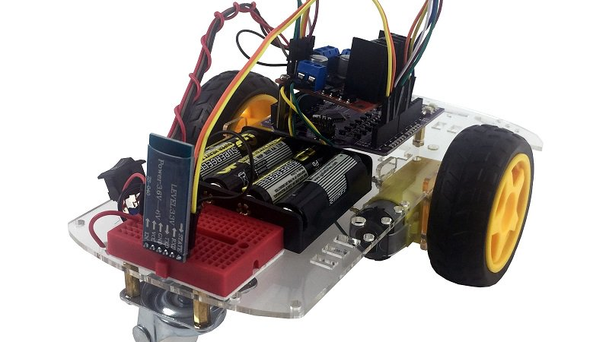
Building the robot chassis
What you would need:
6 x Female to Male jumper wires (retrieve from front row)
7 x Normal wires (retrieve from front row)
Robot Chassis
LN298N Motor Driver
Breadboard
Maker Uno
4 x AA batteries ( EVEREADY or any other conventional ones)

Slide 8
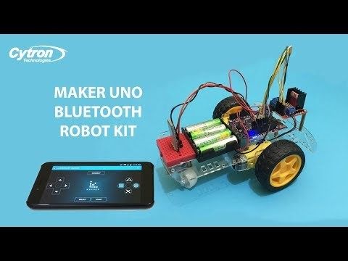
Building instructions

Slide 9


Please open Part 2 PowerPoint
for wiring and testing of robot chassis

